Slide 1
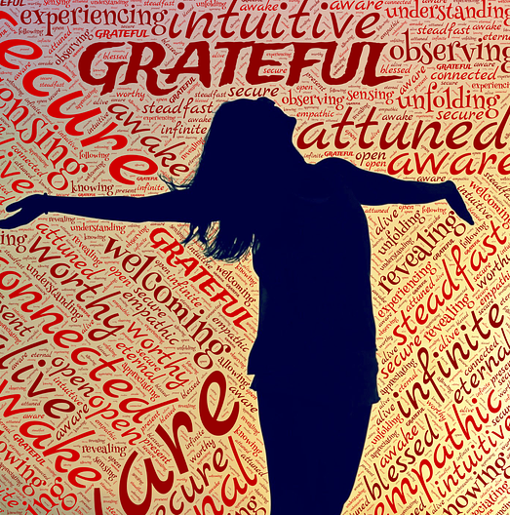
The TOP TEN REASONS to start practicing
GRATITUDE
All Rights Reserved © 216 www.DailyDI.org

Slide 2
Kid President – 25 Things To be Thankful For

Slide 3
WHAT IS GRATITUDE?
According to Google, Gratitude is
“The quality of being THANKFUL; readiness to show appreciation for and to return kindness.”

Slide 4
WHY SHOULD I BE GRATEFUL?
HERE are the TOP TEN
BENEFITS to
Practicing Gratitude.

Slide 5
Top 10 reasons to practice GRATITUDE
GRATITUDE…
MAKES YOU HAPPY
HELPS YOU MAKE FRIENDS
TEACHES YOU TO BE A BETTER FRIEND
MAKES YOU BE A BETTER PERSON
HELP YOU TO FEEL STRONGER – PHYSICALLY & EMOTIONALLY
ALLOWS YOU TO SLEEP
IMPROVES YOUR MENTAL HEALTH
HELPS YOU ACHIEVE
MAKES YOU HEALTHIER
LEADS TO SUCCESS

Slide 6
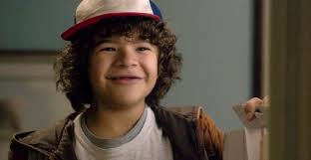
GRATITUDE CAN MAKE YOU
1.
HAPPY!
Gratitude increases POSITIVE EMOTIONS
Joy
Excitement
Enthusiasm
Optimism

Slide 7
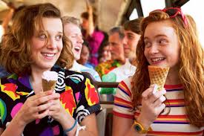
GRATITUDE HELPS YOU MAKE
2.
FRIENDSHIPS
Gratitude helps people make new friends
People who practice
gratitude are
more well-liked
People are drawn to
people who are
thankful

Slide 8
GRATITUDE CAN HELP YOU
3.
SOCIALLY
Gratitude improves our relationships
People who practice gratitude are more
Connected to others
Interested in others
Attentive
Supportive
Helpful
Kind
Compassionate/Caring

Slide 9
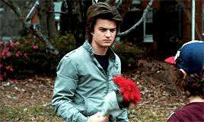
GRATITUDE CAN MAKE YOU
4.
A BETTER PERSON
People who feel grateful often put those feelings into actions. They
are more helpful and kind
tend to PAY IT FORWARD (do for others)
have a stronger bond with the local community & the
environment

Slide 10
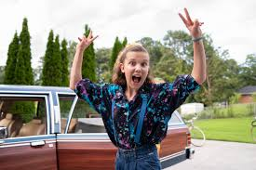
GRATITUDE CAN MAKE YOU
5.
RESILIENT
Gratitude helps people recover from traumatic events
People who practice gratitude are
-more resilient (able to bounce back)
-less likely to hold a grudge
-less likely to respond
negatively to the negative
actions of others
-find the good in all situations

Slide 11
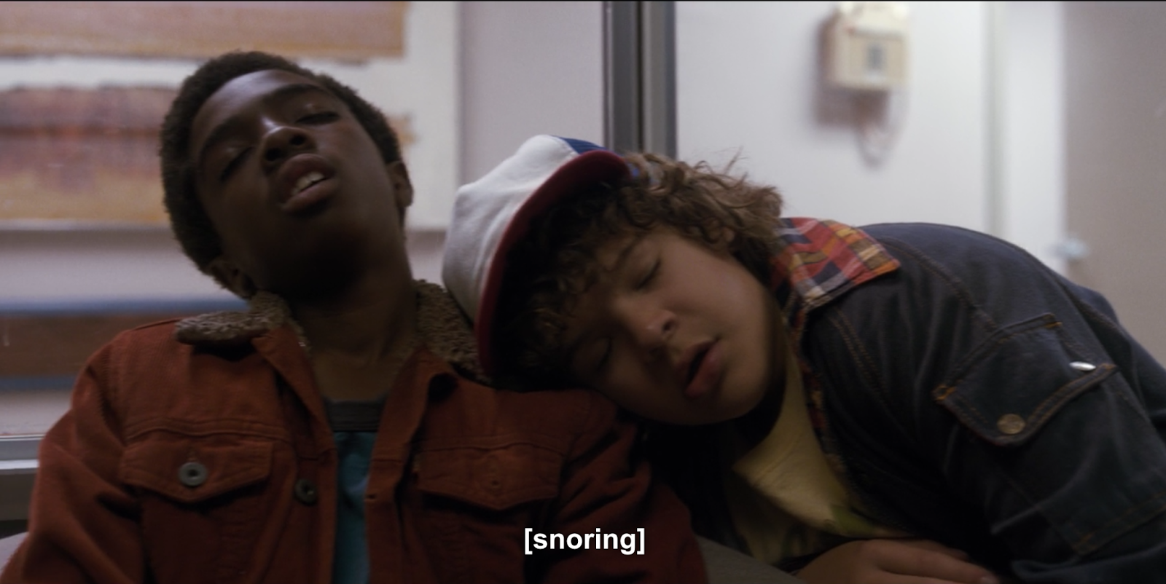
GRATITUDE CAN HELP YOU
6.
SLEEP
When people practice gratitude, they
get more hours of sleep each night
spend less time trying to fall asleep
feel more refreshed when they wake up
BETTER SLEEP HAS LOTS of BENEFITS such as better overall well-being & less physical illness.

Slide 12
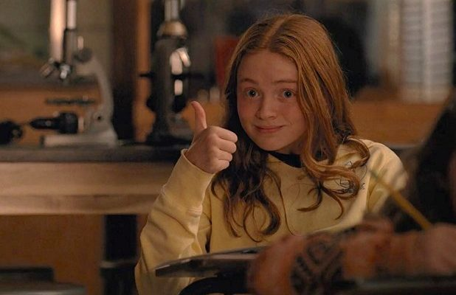
GRATITUDE CAN IMPROVE
7.
MENTAL HEALTH
Gratitude reduces
anger
resentment
frustration
regret
desire to retaliate or get
back at others
stress
ANXIETY &
DEPRESSION

Slide 13
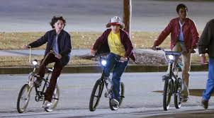
GRATITUDE CAN IMPROVE
PHYSICAL
HEALTH
8.
Gratitude
strengthens the immune system – KEEP YOU HEALTHY
reduces symptoms of illness such as aches and pains
People who practice gratitude are more active and physically fit & make
better choices

Slide 14
GRATITUDE CAN HELP YOU
ACHIEVE
9.
Grateful youth are 20% more likely to do well in school
This is because gratitude
leads to increased self-esteem
& self-worth. You learn to
focus on what really
matters.

Slide 15
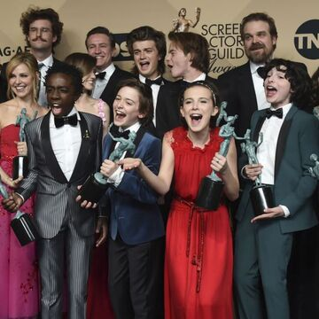
GRATITUDE CAN LEAD TO
10.
SUCCESS
Grateful people are:
more productive
find jobs that allow
them to do things
they enjoy in life
Have more
overall life
satisfaction!

Slide 16
HOW TO PRACTICE GRATITUDE
Keep a Gratitude Journal and list all the things you feel thankful for.
Create a Gratitude Jar – Click on video to watch Mrs. Thompson
Use a Gratitude App – apps like 3 Good Things & gthx:Gratitude
Talk to a friend/family member about what makes you thankful

Slide 17
Try out some of these ideas to show gratitude each day…
Say please & thank you
Help someone less fortunate
say thanks before meals
compliment others
look for the positives
give someone a gift
send a thank you note
make a donation
take a gratitude walk
post thank you notes around your home
post thank-you note in your windows for health workers
keep a personal or family journal

Slide 19
References
http://greatergood.berkeley.edu/pdfs/GratitudePDFs/5Watkins-GratitudeHappiness.pdf
http://greatergood.berkeley.edu/pdfs/GratitudePDFs/2Wood-GratitudeWell-BeingReview.pdf
http://greatergood.berkeley.edu/article/item/pay_it_forward
http://greatergood.berkeley.edu/article/item/a_lesson_in_thanks/
https://www.psychologytoday.com/blog/what-mentally-strong-people-dont-do/201504/7-scientifically-proven-benefits-gratitude
http://happierhuman.com/the-science-of-gratitude/
http://nymag.com/scienceofus/2016/01/how-expressing-gratitude-change-your-brain.html

